Slide 1
Text Categorization
Hongning Wang
CS@UVa

Slide 2
Today’s lecture

Slide 3
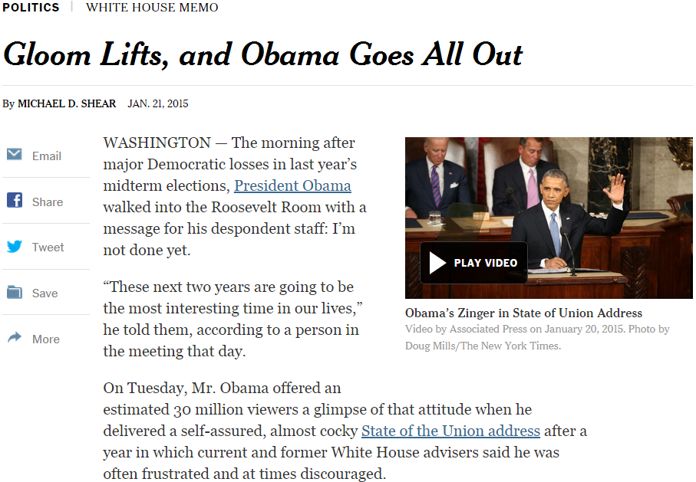
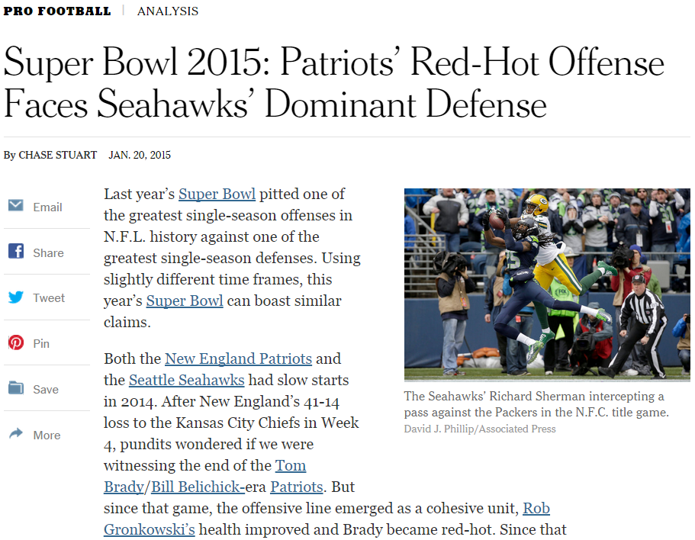
Applications of text categorization
Automatically classify politic news from sports news

Slide 4
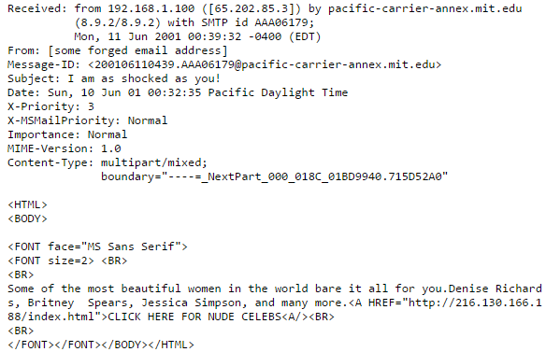
Applications of text categorization
Recognizing spam emails

Slide 5
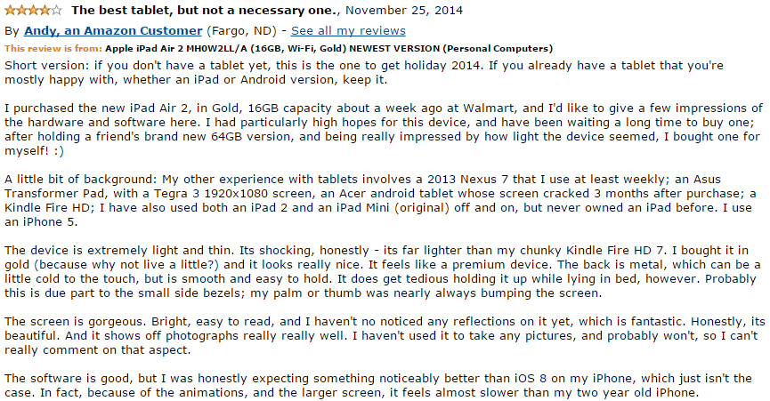
Applications of text categorization
Sentiment analysis

Slide 6
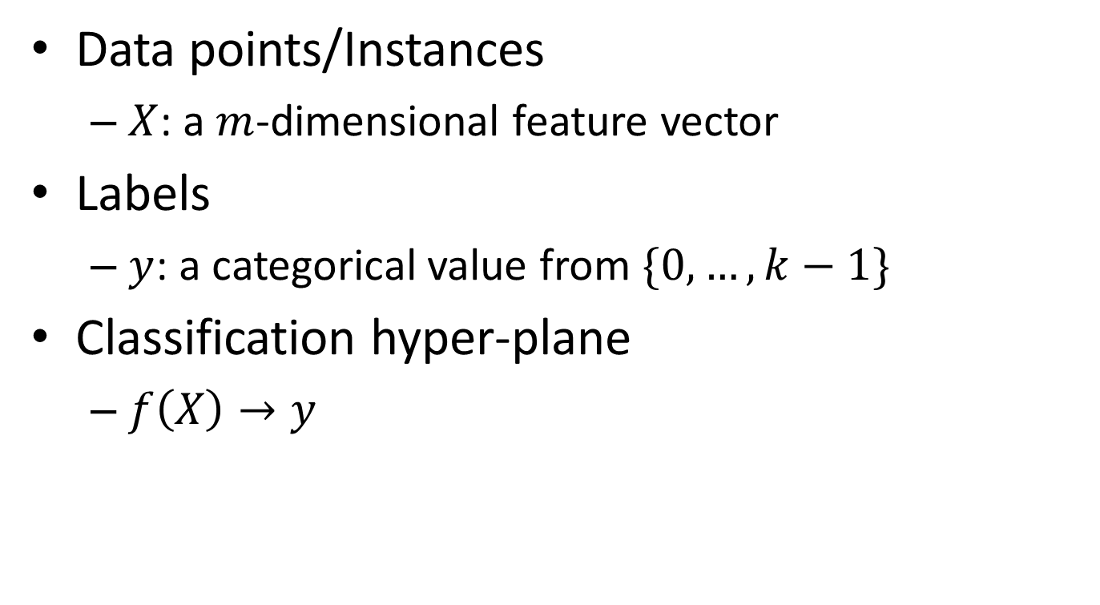
Basic notions about categorization
Data points/Instances
$X$: a $m$-dimensional feature vector
Labels
$y$: a categorical value from $\{0,…,k−1\}$
Classification hyper-plane
$f\left(X\right)→y$

Slide 7
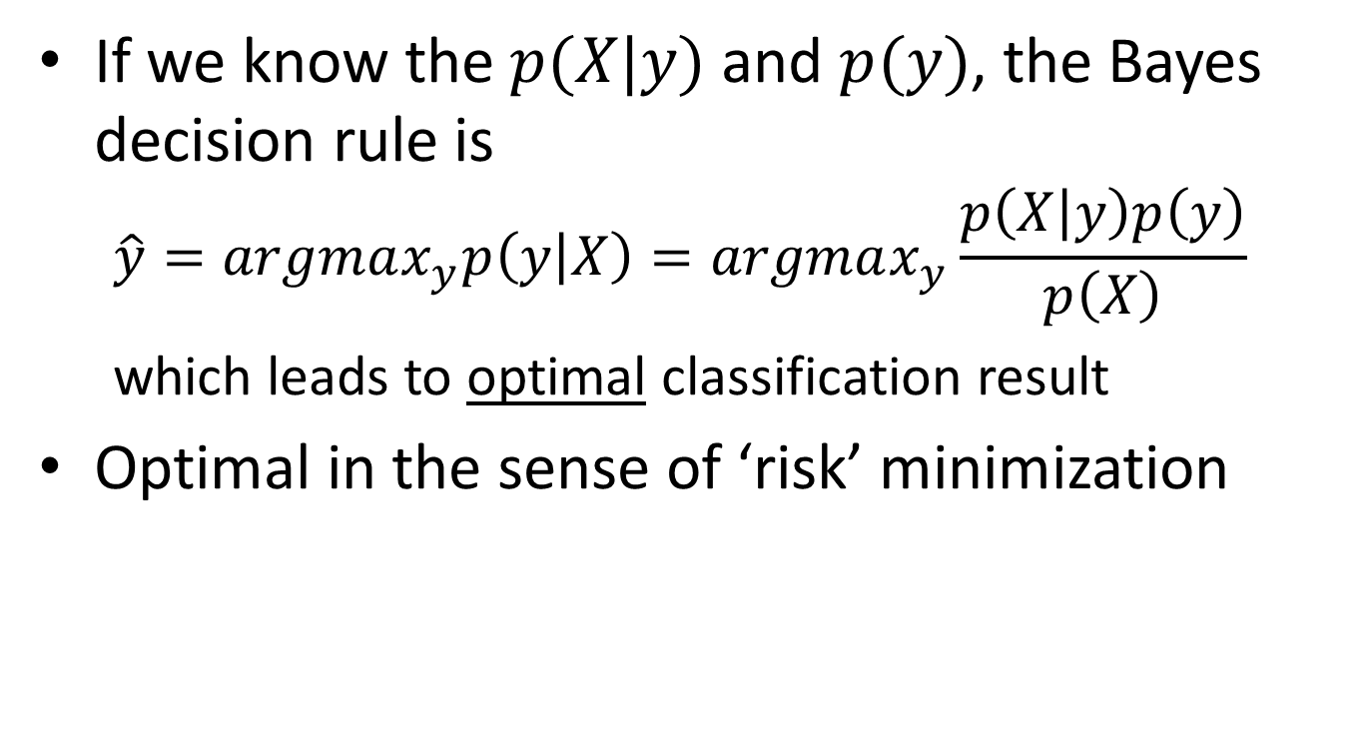
Bayes decision theory
If we know the $p(X|y)$ and $p(y)$, the Bayes decision rule is
$$\hat{y}=argmax_{y}p\left(y | X\right)=argmax_{y}\frac{p\left(X | y\right)p\left(y\right)}{p\left(X\right)}$$
which leads to optimal classification result
Optimal in the sense of ‘risk’ minimization

Slide 8
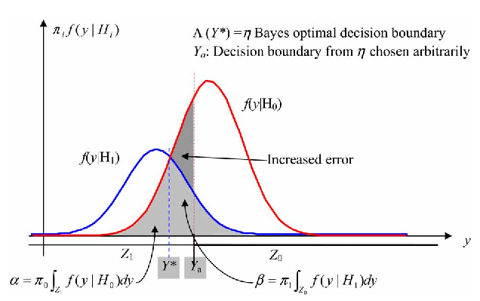

Bayes risk
Risk – assign instance to a wrong class
Type I error: $(y^{∗}=1, \hat{y}=0)$
$p\left(X | y=1\right)p(y=1)$
Type II error: $(y^{∗}=0, \hat{y}=1)$
$p\left(X | y=0\right)p(y=0)$
Risk by Bayes decision rule
$R(X)=min⁡\{p\left(X | y=1\right)p\left(y=1\right), p\left(X | y=0\right)p(y=0)\}$

